Slide 1

A Database System for Sephora’s Online Shop
CSC3170 Group Project
Group 6
陈桂铭 119010012
梁佳蕊 119010170
唐婉婷 119010278
潘嘉琳 119020040
张允涵 119020076
陈雨维 120090256
马可轩 120090651
梁明睿 120090723

Slide 2
Part 01
Introduction

Slide 3
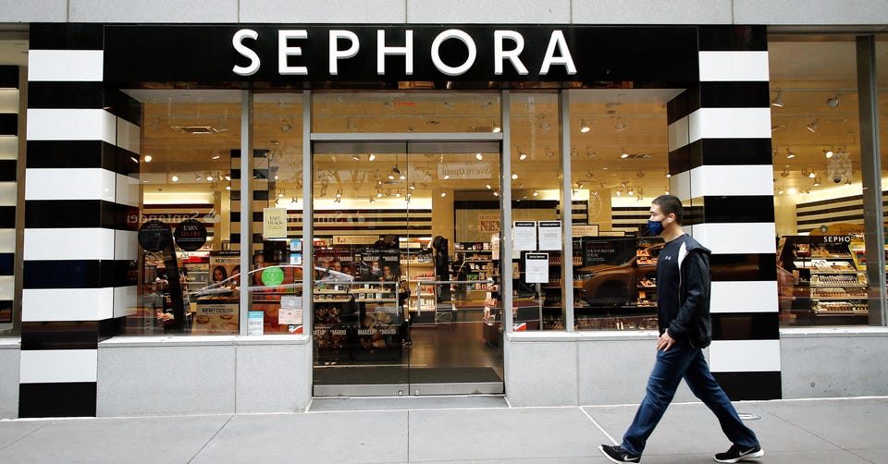
Introduction
Sephora is a retailer of personal care and beauty products with nearly 340 brands.
(Like a Walmarts but for beauty products)
Sephora has both offline store and online store.

Slide 4
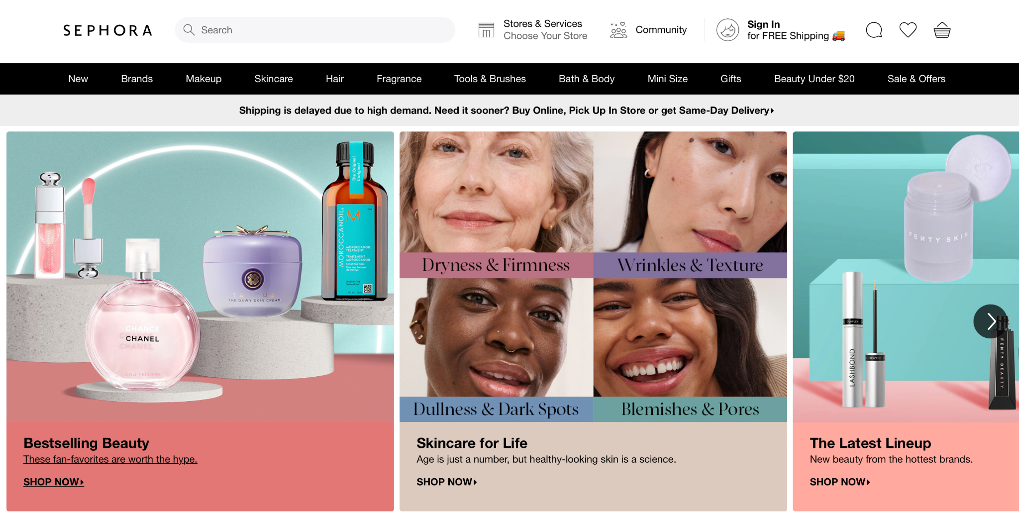
Introduction
Notations:
Entities
Sephora’s online store.
Attributes
Notes:
Overview of sephora’s website

Slide 5
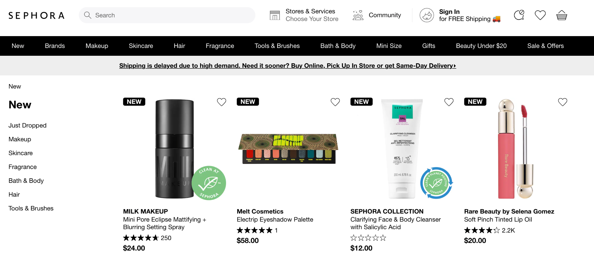
Introduction
Products
Brands

Slide 6
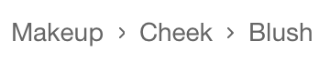
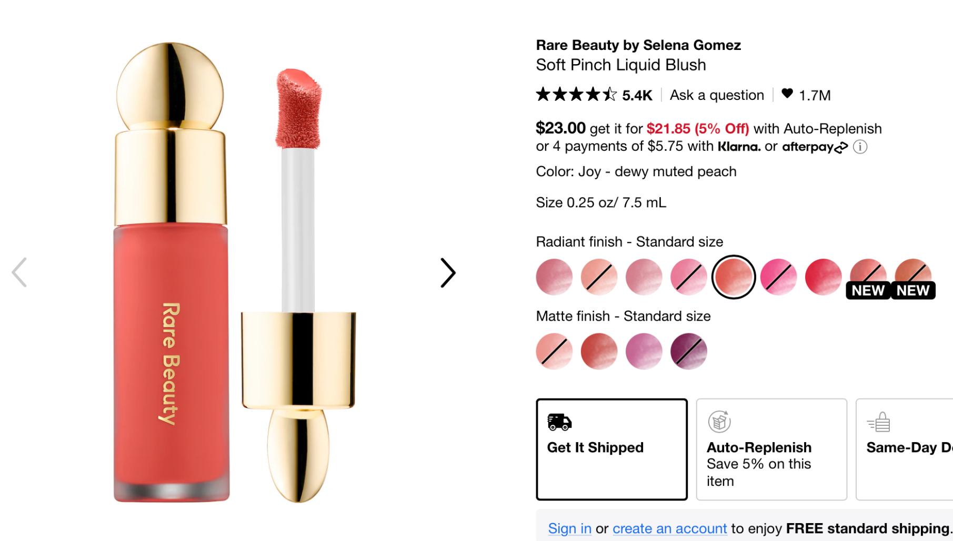

Products Details
Introduction
Category
Name
Price
Inventory

Slide 7
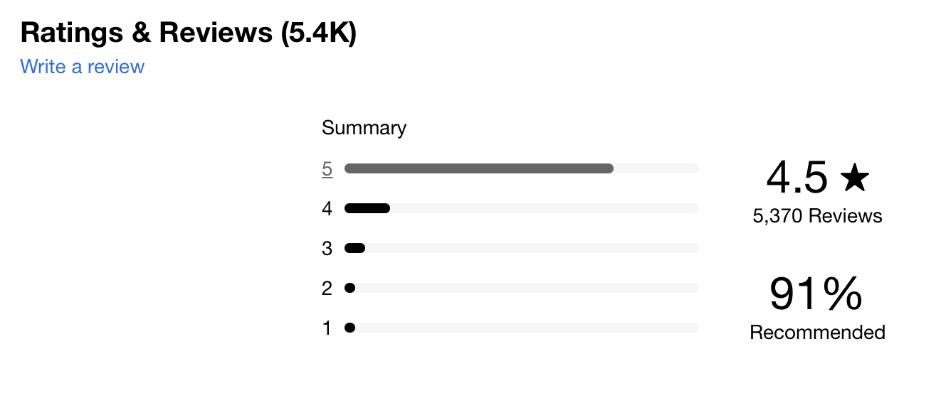
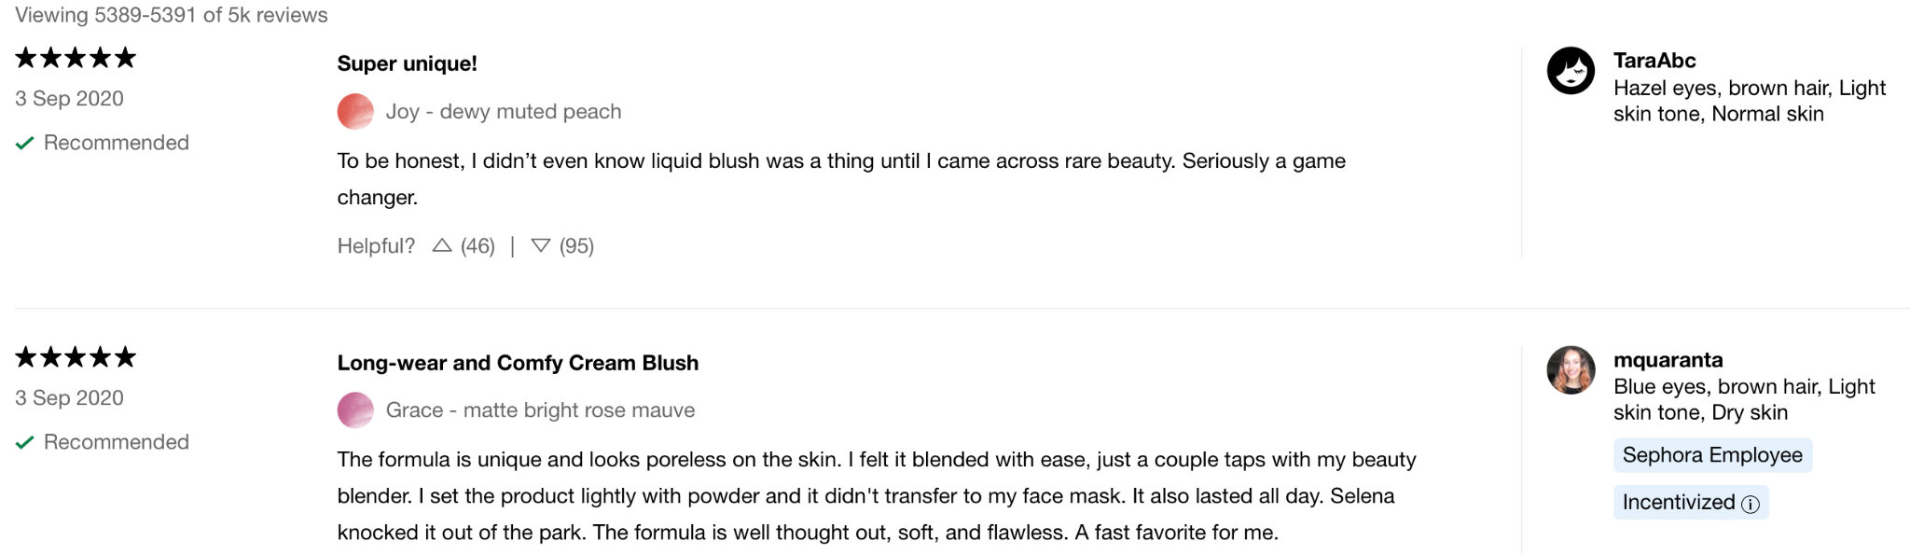
Introduction
Ratings
Reviews Details
Comments
Date
Users

Slide 8
Introduction
GOAL:
Construct a database system for the website of Sephora’s online store.

Slide 9
Part 02
Database Design

Slide 10






Entities & Attributes
Product
Brand
User
Order
Compliant
Skin
Name
Inventory
Price
Category
Name
ID
Name
Age
ID
TimeStamp
ItemPrcie
TotalShippingCost
ItemQuantity
ShippingAddress
TotalCost
ID
Status
CompliantDate
ResolutionDate
SkinType

Slide 11
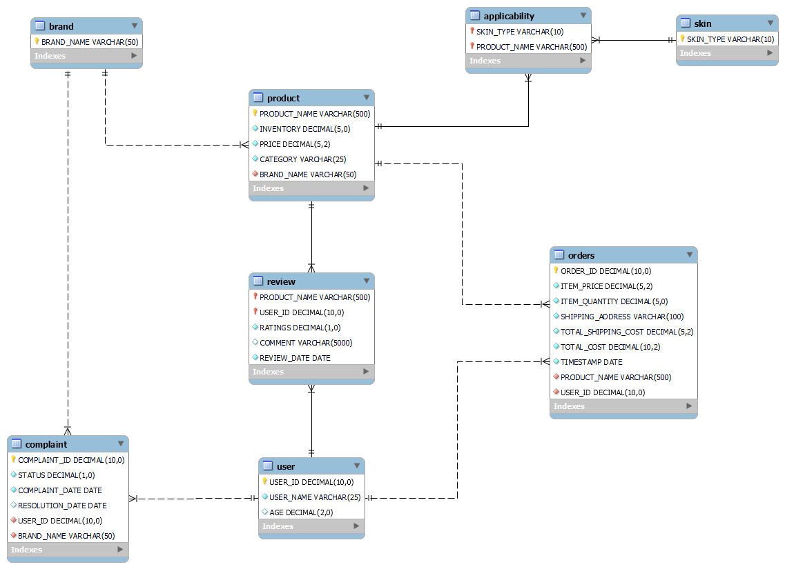
ER Modeling: Supply Side
About Product Price
Subject to change
Always record the latest price
Supply Side
About Skin Type
“Dry”, “Oily”, “Normal”
Each product can be applicable to multiple types of skin
Each skin type can fit in multiple products

Slide 12
ER Modeling: Demand Side
About Order
Assumption (jiarui)
Each order contains only one product.
The quantity of the product can be more than one.
“ITEM_PRICE” refers to the product price at the time user placed the order.
About Review
Users can write reviews for products.
About Complaint
Demand Side
Users can file complaints against brands.

Slide 13
Part 03
Data Collection & Generation

Slide 14
Data Collection and Generation
Collected Data
Cosmetics datasets:
https://www.kaggle.com/datasets/kingabzpro/cosmetics-datasets
Sephora Website:
https://www.kaggle.com/datasets/raghadalharbi/all-products-available-on-sephora-website
Python packages: random, numpy, pandas
Cutting-edge language model: phoenix-inst-chat-7b
Generated Data
Chen, Z., Jiang, F., Chen, J., Wang, T., Yu, F., Chen, G., ... & Li, H. (2023). Phoenix: Democratizing ChatGPT across Languages. arXiv preprint arXiv:2304.10453.

Slide 15
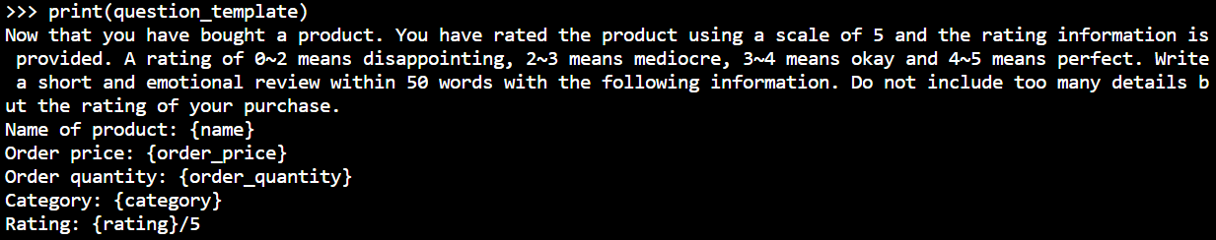
Data Collection and Generation
Generate `review.COMMENT` using Phoenix-inst-chat-7b:
Chen, Z., Jiang, F., Chen, J., Wang, T., Yu, F., Chen, G., ... & Li, H. (2023). Phoenix: Democratizing ChatGPT across Languages. arXiv preprint arXiv:2304.10453.

Slide 16
Data Collection and Generation
Generated samples:
😓
“I was so excited to purchase the Wisteria Blue product, but my expectations were not met. I expected a stunning color and quality, but the product was disappointingly mediocre. I would rate this purchase 2 out of 5.”
⭐⭐⚝ ⚝ ⚝
“Just received my order of Gucci Bloom Gocce di Fiori Eau de Toilette for Her and I must say, I am so impressed! The fragrance is divine, with a perfect blend of sweet and floral notes that leaves a lasting impression. The packaging is also stunning, making it the perfect addition to my collection. I would definitely give this product a rating of 4/5, and I can't wait to share it with my friends. Thank you, Sephora, for delivering such a fantastic product!”
😋
⭐⭐⭐⭐ ⚝

Slide 17
Part 04
Queries and Results

Slide 18
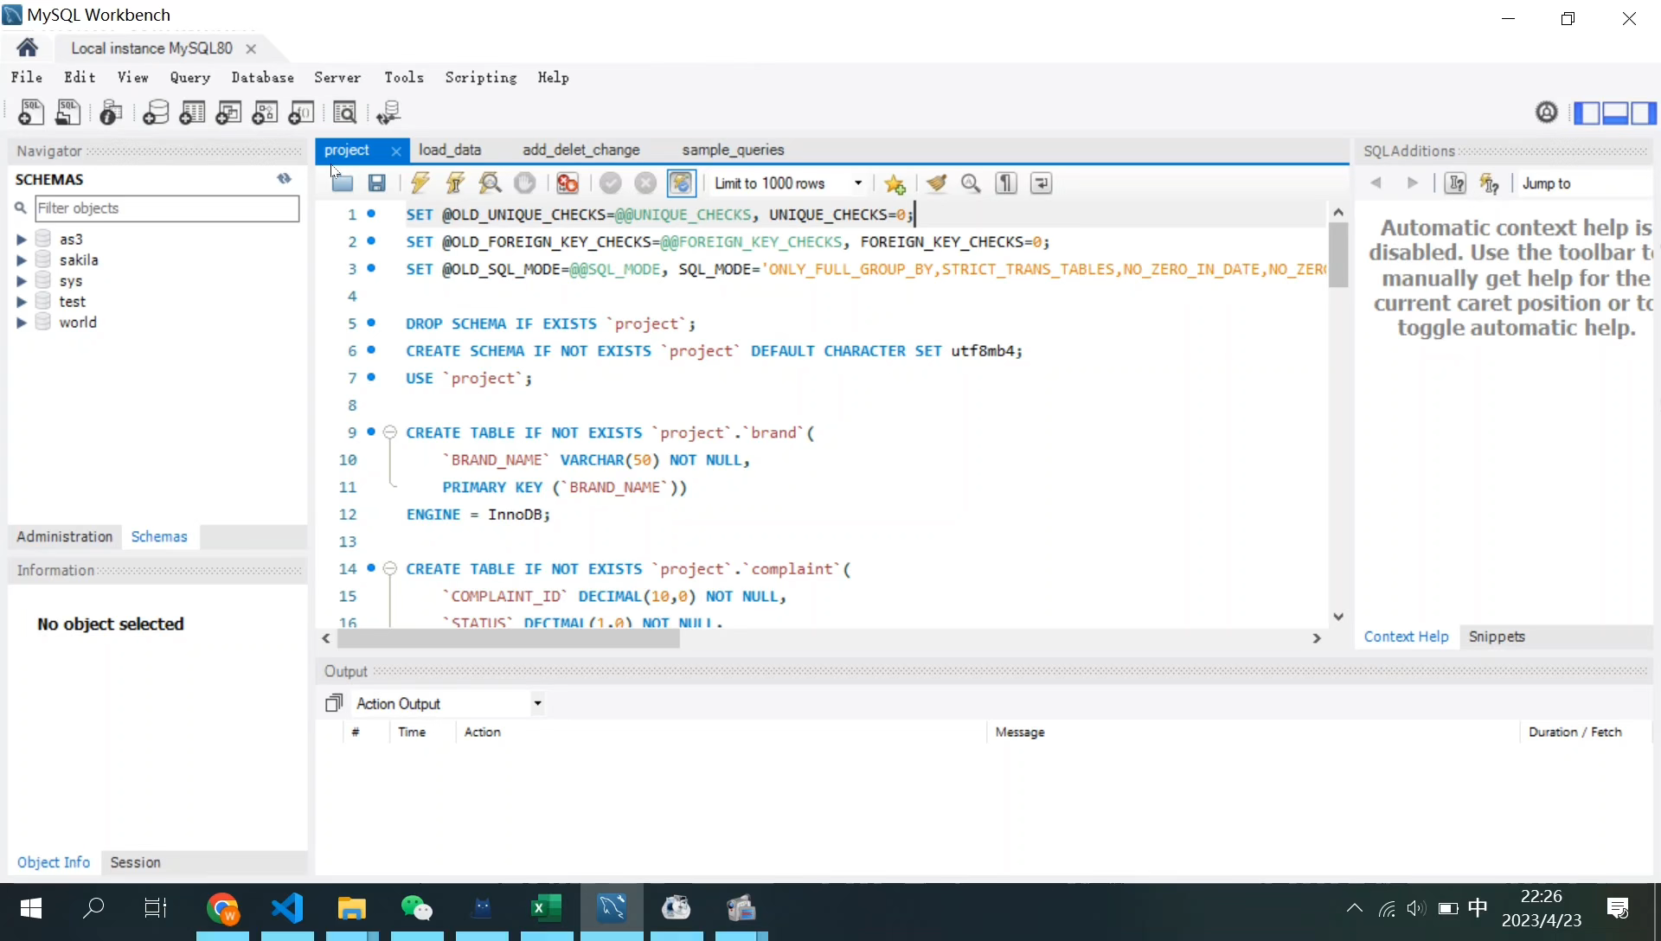
Demo of SQL Implementation

Slide 19
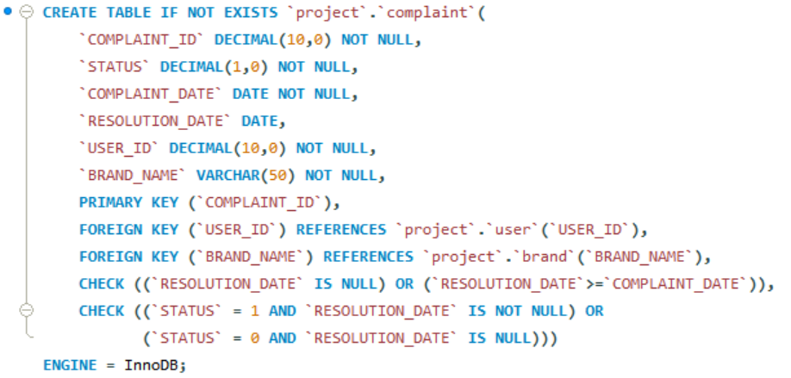
Create Tables: Foundation
Eg: complaint
Add some checks to satisfy the constraints we set.

Slide 20
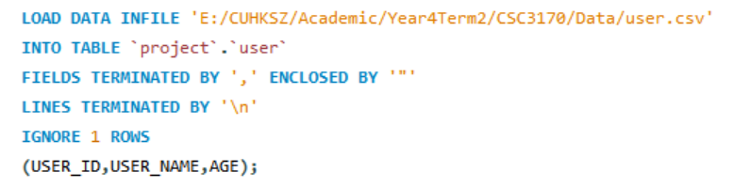
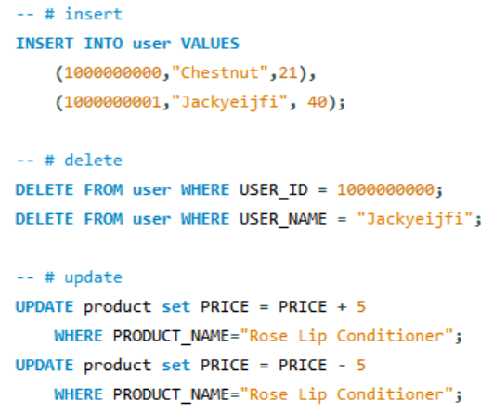
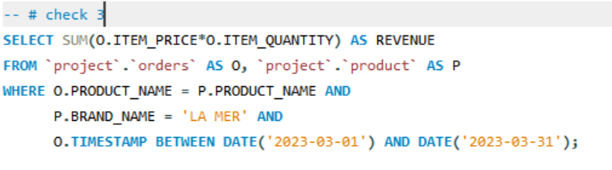
Load Data
Eg: Load user.csv into the table project.user
File address
Basic Queries: Add, Delete, Modify and Check

Slide 21
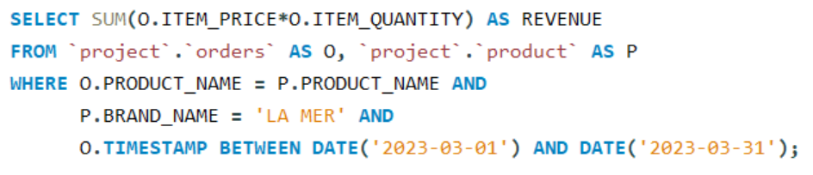
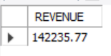
Sample Queries
1. Retrieve the total revenue generated by a specific brand (LA MER) in March 2023.
Calculate revenue
Join by PRODUCT_NAME
Results:
Specify conditions

Slide 22
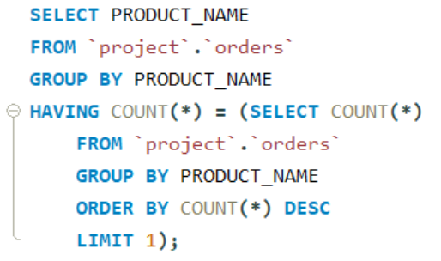
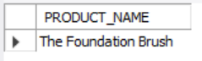
Sample Queries
2. Retrieve the most commonly ordered product.
Calculate the maximum number of orders for one product
Results:

Slide 23
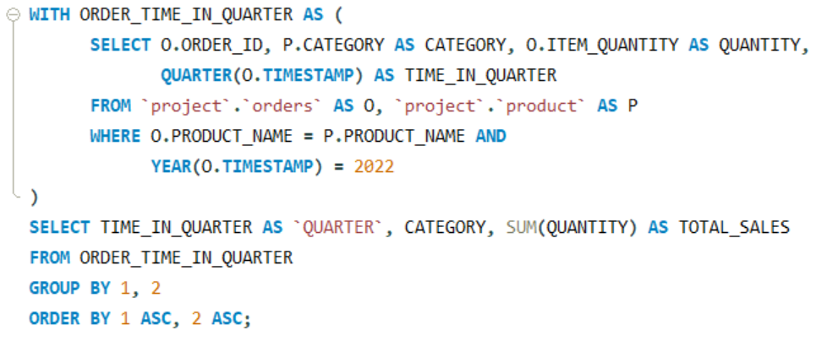
Sample Queries
3. Is there any relationship between the demands of the products of each category and the seasons?
Convert time into quarter & Filter the orders for 2022

Slide 24
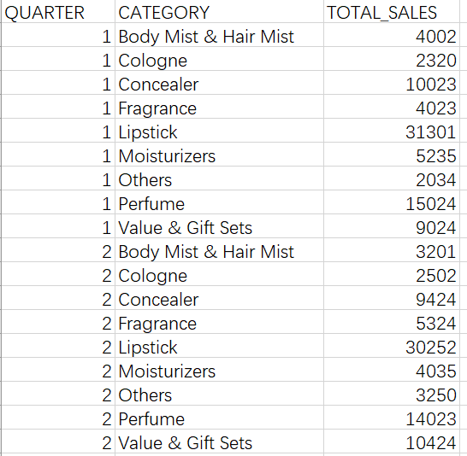
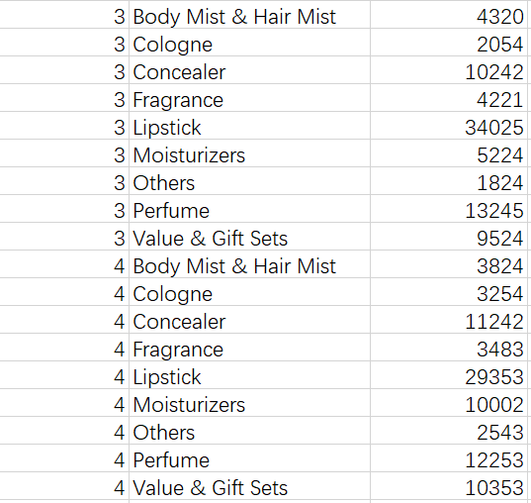
Sample Queries
3. Is there any relationship between the demands of the products of each category and the seasons?

Slide 25
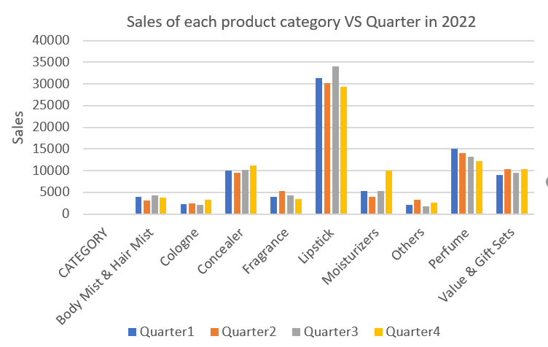
Sample Queries
3. Is there any relationship between the demands of the products of each category and the seasons?
Almost DOUBLED in the 4th quarter!!

Slide 26
Part 05
Limitation & Conclusion

Slide 27
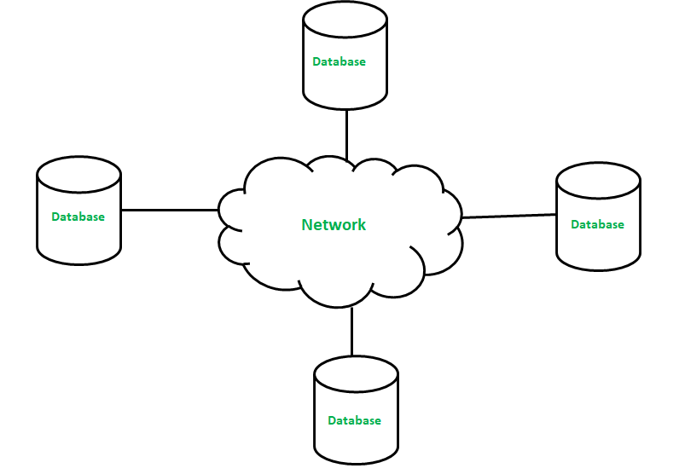

Limitations
We only focus on the operation side of the company
Hard to deal with large amount of data
Cannot deal with real time querying
May use advanced database, e.g. NoSQL
Conclusion
Extendible
Easy to modify and maintain
Safe

Slide 28
THANK
YOU
Q & A

